Slide 1
Java Utilities: Annotations

Slide 2
Introduction
Annotations in Java are metadata that provide additional information about the program without affecting its execution.
Java annotations are used for various purposes, mainly falling into three broad categories:
✔ Compiler Instructions → Helps the Java compiler detect errors, enforce rules, and suppress warnings. ✔ Code Analysis → Used by IDEs, static analysis tools, and frameworks to analyze code for correctness and best practices. ✔ Runtime Processing → Used by frameworks like Spring, Hibernate, and Java Reflection API to process annotations dynamically during execution.

Slide 3
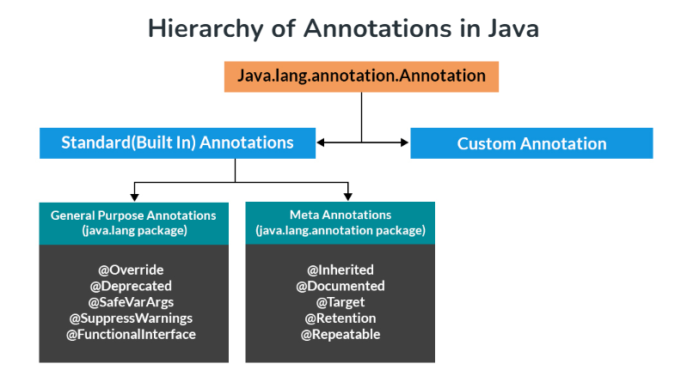
Notes:
Java provides meta-annotations, which are used to define the behavior of custom annotations.

Slide 4
Built-In Java Annotations
There are several built-in annotations in Java. Some annotations are applied to Java code and some to other annotations.
Built-In Java Annotations used in Java code
@Override
@SuppressWarnings
@Deprecated
Built-In Java Annotations used in other annotations
@Target
@Retention
@Inherited
@Documented

Slide 5
Understanding Built-In Annotations -
Let's understand the built-in annotations first.
@Override -
@Override annotation assures that the subclass method is overriding the parent class method. If it is not so, compile time error occurs.
Sometimes, we does the silly mistake such as spelling mistakes etc. So, it is better to mark @Override annotation that provides assurity that method is overridden.

Slide 6
class Animal{
void eatSomething(){System.out.println("eating something");}
}
class Dog extends Animal{
@Override
void eatsomething(){System.out.println("eating foods");}//should be eatSomething
}
class TestAnnotation1{
public static void main(String args[]){
Animal a=new Dog();
a.eatSomething();
}}
Output – compile time error.
If we remove @Override from above code -
Since Dog does not override eatSomething() (due to incorrect method name eatsomething()), Java treats it as a separate method.
When a.eatSomething() is called, it executes the eatSomething() method from Animal, not Dog.
No compilation error occurs, but the intended override does not happen.

Slide 7
@SuppressWarnings
The @SuppressWarnings annotation is used to instruct the compiler to ignore specific warnings that it would normally generate.
class OldClass {
@Deprecated
void oldMethod() {
System.out.println("This is a deprecated method");
}
}
public class Test {
@SuppressWarnings("deprecation") // Suppresses warnings about using deprecated methods
public static void main(String[] args) {
OldClass obj = new OldClass();
obj.oldMethod(); // No warning due to suppression
}
}

Slide 8
@Deprecated
@Deprecated annoation marks that this method is deprecated so compiler prints warning. It informs user that it may be removed in the future versions. So, it is better not to use such methods.
class A{
void m(){System.out.println("hello m");}
@Deprecated
void n(){System.out.println("hello n");}
}
class TestAnnotation3{
public static void main(String args[]){
A a=new A();
a.n();
}}

Slide 9
Java Custom annotations -
Java Custom annotations or Java User-defined annotations are easy to create and use. The @interface element is used to declare an annotation. For example:
@interface MyAnnotation{}
Here, MyAnnotation is the custom annotation name.
Types of Annotation -
There are three types of annotations.
Marker Annotation
Single-Value Annotation
Multi-Value Annotation

Slide 10
1) Marker Annotation
An annotation that has no method, is called marker annotation. For example:
@interface MyAnnotation{}
The @Override and @Deprecated are marker annotations.
2) Single-Value Annotation
An annotation that has one method, is called single-value annotation. For example:
@interface MyAnnotation{
int value();
}
We can provide the default value also. For example:
@interface MyAnnotation{
int value() default 0;
}
How to apply Single-Value Annotation
Let's see the code to apply the single value annotation.
@MyAnnotation(value=10)
The value can be anything.

Slide 11
3) Multi-Value Annotation
An annotation that has more than one method, is called Multi-Value annotation. For example:
@interface MyAnnotation{
int value1();
String value2();
String value3();
}
}
We can provide the default value also. For example:
@interface MyAnnotation{
int value1() default 1;
String value2() default "";
String value3() default "xyz";
}
How to apply Multi-Value Annotation
Let's see the code to apply the multi-value annotation.
@MyAnnotation(value1=10,value2="Arun Kumar",value3="Ghaziabad")

Slide 12
Retention Policy of Annotations -
Annotations have a retention policy, which decides where the annotation is retained.
Retention Types:
SOURCE → Discarded during compilation (e.g., @Override).
CLASS → Present in class file but not available at runtime.
RUNTIME → Available at runtime (used in reflection).

Slide 13
Example –
import java.lang.annotation.*;
@Retention(RetentionPolicy.RUNTIME) // Annotation available at runtime
@interface MyAnnotation {
String name();
}

Slide 14
import java.lang.annotation.*;
import java.lang.reflect.*;
@Retention(RetentionPolicy.RUNTIME)
@interface MyAnnotation {
String name();
}
@MyAnnotation(name = "Test Class")
class Test {
public static void main(String[] args) {
Class<Test> obj = Test.class;
// Checking if annotation is present
if (obj.isAnnotationPresent(MyAnnotation.class)) {
MyAnnotation annotation = obj.getAnnotation(MyAnnotation.class);
System.out.println("Annotation Value: " + annotation.name());
}
}
}
Notes:
Class<T> is a generic class in Java's Reflection API that represents a Java class or interface at runtime.Here, Class<Test> means that obj is a reference to the Class object of Test.
Reflection is a powerful feature in Java that allows a program to inspect, analyze, and modify classes, methods, and fields at runtime. It is part of the java.lang.reflect package.

Slide 15
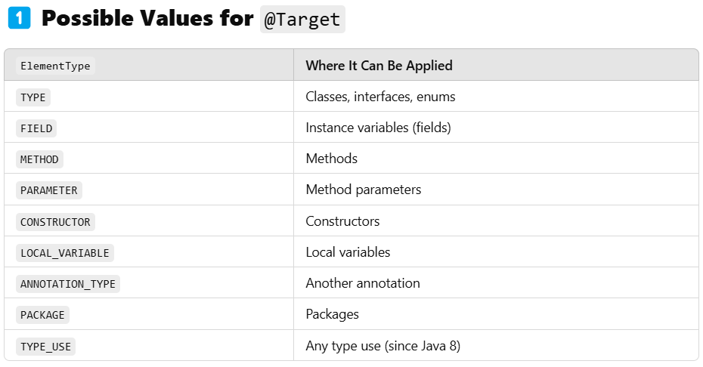
@Target Annotation in Java
The @Target annotation in Java restricts where an annotation can be applied.

Slide 16
Restricting an Annotation to Methods –
import java.lang.annotation.ElementType;
import java.lang.annotation.Target;
// Custom annotation that can only be applied to methods
@Target(ElementType.METHOD)
@interface MyMethodAnnotation {
}
class Example {
@MyMethodAnnotation
public void display() {
System.out.println("Method with custom annotation");
}
}
If you try applying @MyMethodAnnotation to a class or field, it will cause a compilation error.

Slide 17
Applying an Annotation to Multiple Elements
import java.lang.annotation.ElementType;
import java.lang.annotation.Target;
@Target({ElementType.METHOD, ElementType.FIELD}) // Can be used on methods and fields
@interface MyAnnotation {
}
class Test {
@MyAnnotation
private String name; // Allowed
@MyAnnotation
public void show() { // Allowed
System.out.println("Hello!");
}
}
This annotation can be applied to both methods and fields.

Slide 18
@Inherited Annotation –
The @Inherited annotation in Java allows an annotation from a superclass to be inherited by its subclasses.
Normally, annotations are not inherited by subclasses. If you want a subclass to inherit an annotation from its parent class, you can use @Inherited.
import java.lang.annotation.ElementType;
import java.lang.annotation.Inherited;
import java.lang.annotation.Retention;
import java.lang.annotation.RetentionPolicy;
import java.lang.annotation.Target;
// Define an inherited annotation
@Inherited
@Retention(RetentionPolicy.RUNTIME)
@Target(ElementType.TYPE) // Applies to classes only
@interface MyAnnotation {
String value();
}
// Apply annotation to the superclass
@MyAnnotation("Applied to Parent Class")
class Parent {
}
// Subclass does NOT explicitly have the annotation
class Child extends Parent {
}

Slide 19
import java.lang.reflect.AnnotatedElement;
public class InheritedExample {
public static void main(String[] args) {
// Get the Class object for Child
Class<?> obj = Child.class;
// Check if MyAnnotation is present in Child
if (obj.isAnnotationPresent(MyAnnotation.class)) {
MyAnnotation annotation = obj.getAnnotation(MyAnnotation.class);
System.out.println("Inherited Annotation Value: " + annotation.value());
} else {
System.out.println("Annotation NOT present in Child class.");
}
}
}
Even though Child does not explicitly have @MyAnnotation, it inherits it from Parent.
If we remove @Inherited from @MyAnnotation, the subclass will NOT inherit it.

Slide 20
Accessing annotation from methods –
import java.lang.annotation.ElementType; import java.lang.annotation.Retention; import java.lang.annotation.RetentionPolicy; import java.lang.annotation.Target; import java.lang.reflect.*; @Retention(RetentionPolicy.RUNTIME) @Target(ElementType.METHOD) @interface MyAnnotaion{ int value1(); String value2(); float value3(); } public class Main { @MyAnnotaion(value1 = 10, value2 = "Hello", value3 = 1.12f) public void test(){ } public static void main(String[] args) throws Exception{ Method method = Main.class.getDeclaredMethod("test"); if(method.isAnnotationPresent(MyAnnotaion.class)){ MyAnnotaion myAnnotaion = method.getAnnotation(MyAnnotaion.class); System.out.println(myAnnotaion.value1()); System.out.println(myAnnotaion.value2()); System.out.println(myAnnotaion.value3()); } else { System.out.println("Annotation not present"); } } }

Slide 21
Accessing from fields –
import java.lang.annotation.*;
import java.lang.reflect.*;
// Define the annotation
@Retention(RetentionPolicy.RUNTIME)
@Target(ElementType.FIELD) // Restrict usage to fields
@interface MyFieldAnnotation {
String name();
int age();
}
// Use the annotation on fields
class Person {
@MyFieldAnnotation(name = "John Doe", age = 30)
private String personInfo;
}
public class Main {
public static void main(String[] args) {
try {
// Get the class object
Class<Person> obj = Person.class;
// Iterate over declared fields
for (Field field : obj.getDeclaredFields()) {
// Check if the annotation is present on the field
if (field.isAnnotationPresent(MyFieldAnnotation.class)) {
// Get the annotation instance
MyFieldAnnotation annotation = field.getAnnotation(MyFieldAnnotation.class);
// Print annotation values
System.out.println("Field: " + field.getName());
System.out.println("Name: " + annotation.name());
System.out.println("Age: " + annotation.age());
}
}
} catch (Exception e) {
e.printStackTrace();
}
}
}

Slide 22
Practice questions –
1- Create a custom annotation @Info with fields author and version. Apply it to a class and retrieve its values using reflection.
2- Write a Java program to use @Override annotation to ensure a subclass properly overrides a method from its superclass.
3- Implement a Java class with a deprecated method. Use @SuppressWarnings("deprecation") to call the method without warnings.
4- Define a custom annotation @Task that can be applied only to methods using @Target. Write a class where this annotation is correctly applied.

Slide 23
5 - Implement a program where an annotation marked with @Inherited is applied to a parent class. Check if the child class inherits it.
6 - Create a Java annotation @LogExecutionTime that can be applied to methods. Use reflection to check if the annotation is present.
7 - Write a program that defines a runtime-retained annotation @Debug and applies it to methods. Retrieve it dynamically using reflection.
8 - Use @Documented annotation to define an annotation that appears in generated JavaDocs. Apply it to a class and verify its visibility in documentation.

Slide 24
1 –
import java.lang.annotation.*;
import java.lang.reflect.*;
@Retention(RetentionPolicy.RUNTIME) // Available at runtime
@Target(ElementType.TYPE) // Applicable to classes
@interface Info {
String author();
String version();
}
// Applying annotation
@Info(author = "John Doe", version = "1.0")
class MyClass {
}
public class AnnotationTest {
public static void main(String[] args) {
Class<MyClass> obj = MyClass.class;
// Check if annotation is present
if (obj.isAnnotationPresent(Info.class)) {
Info info = obj.getAnnotation(Info.class);
System.out.println("Author: " + info.author());
System.out.println("Version: " + info.version());
}
}
}

Slide 25
2 –
class Parent {
void show() {
System.out.println("Parent class method");
}
}
class Child extends Parent {
@Override
void show() { // Ensures correct method override
System.out.println("Child class method");
}
}
public class OverrideExample {
public static void main(String[] args) {
Parent obj = new Child();
obj.show();
}
}

Slide 26
3 –
class OldClass {
@Deprecated
public void oldMethod() {
System.out.println("This is a deprecated method.");
}
}
public class SuppressWarningsExample {
public static void main(String[] args) {
OldClass obj = new OldClass();
@SuppressWarnings("deprecation")
obj.oldMethod(); // No warning displayed
}
}

Slide 27
4 –
import java.lang.annotation.*;
@Retention(RetentionPolicy.RUNTIME)
@Target(ElementType.METHOD) // Can be applied only to methods
@interface Task {
String description();
}
class Work {
@Task(description = "This is a sample task")
public void doWork() {
System.out.println("Task is being executed.");
}
}
public class TaskExample {
public static void main(String[] args) {
Work obj = new Work();
obj.doWork();
}
}

Slide 28
5 –
import java.lang.annotation.*;
@Retention(RetentionPolicy.RUNTIME)
@Target(ElementType.TYPE)
@Inherited // Allows inheritance of annotation
@interface InheritedAnnotation {
String value();
}
@InheritedAnnotation(value = "Parent Class Annotation")
class Parent {}
class Child extends Parent {}
public class InheritedAnnotationExample {
public static void main(String[] args) {
if (Child.class.isAnnotationPresent(InheritedAnnotation.class)) {
InheritedAnnotation annotation = Child.class.getAnnotation(InheritedAnnotation.class);
System.out.println("Child class inherited annotation: " + annotation.value());
} else {
System.out.println("Child class did not inherit annotation.");
}
}
}

Slide 29
6 –
import java.lang.annotation.*;
import java.lang.reflect.*;
@Retention(RetentionPolicy.RUNTIME)
@Target(ElementType.METHOD)
@interface LogExecutionTime {}
class TestClass {
@LogExecutionTime
public void execute() {
System.out.println("Executing method...");
}
}
public class LogExecutionTimeExample {
public static void main(String[] args) throws Exception {
Method method = TestClass.class.getMethod("execute");
if (method.isAnnotationPresent(LogExecutionTime.class)) {
System.out.println("LogExecutionTime annotation is present!");
}
}
}

Slide 30
7 –
import java.lang.annotation.*;
import java.lang.reflect.*;
@Retention(RetentionPolicy.RUNTIME) // Available at runtime
@Target(ElementType.METHOD)
@interface Debug {
String level();
}
class DebugExample {
@Debug(level = "HIGH")
public void testMethod() {
System.out.println("Debugging...");
}
}
public class DebugReflectionExample {
public static void main(String[] args) throws Exception {
Method method = DebugExample.class.getMethod("testMethod");
if (method.isAnnotationPresent(Debug.class)) {
Debug debug = method.getAnnotation(Debug.class);
System.out.println("Debug Level: " + debug.level());
}
}
}

Slide 31
8 –
import java.lang.annotation.*;
/**
* Custom annotation that will appear in JavaDocs
*/
@Documented
@Retention(RetentionPolicy.RUNTIME)
@Target(ElementType.TYPE)
@interface API {
String version();
}
/**
* This is a sample class using @API annotation.
*/
@API(version = "2.1")
class MyService {
public void perform() {
System.out.println("Service running...");
}
}
public class DocumentedAnnotationExample {
public static void main(String[] args) {
MyService service = new MyService();
service.perform();
}
}

